Slide 1
Oct 13 update

Slide 2
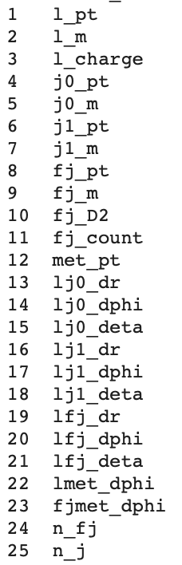
Baseline DNN model ready…
Inputs: see the right table
preselection:
1. must have 1 lep, 2 jets, 1 fat jet
2. Lepton inside the fat jet (dR <1)
3. For signals, true higgs inside the fat jet (dR < 1)

Slide 3
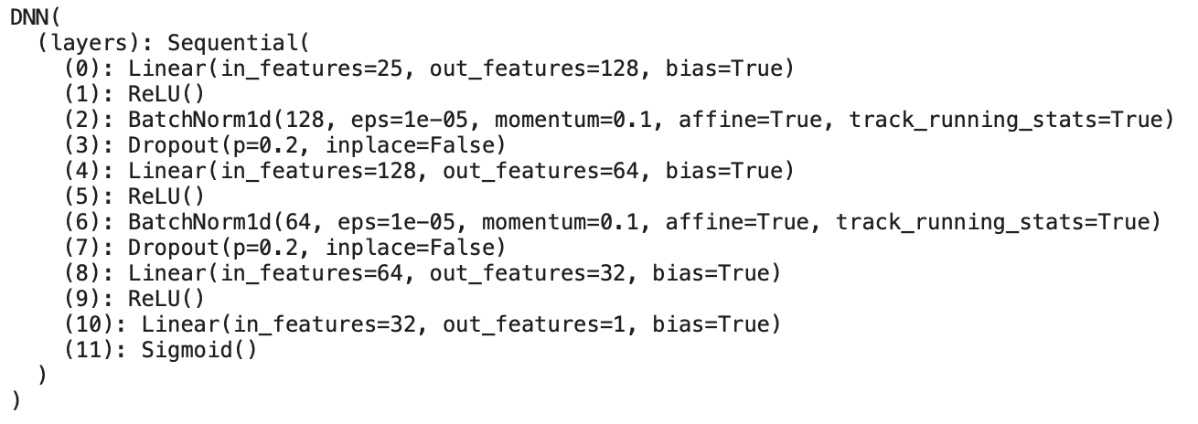
Numbers
Start with signal 2 500 000 events, 254 733 passing selection
Start with background total 1 500 000 events, 58558 passing selection
final balanced dataset (58558 signal, 58558 background)

Slide 4
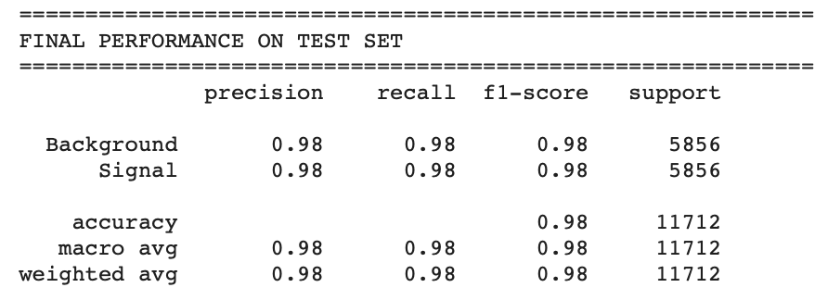
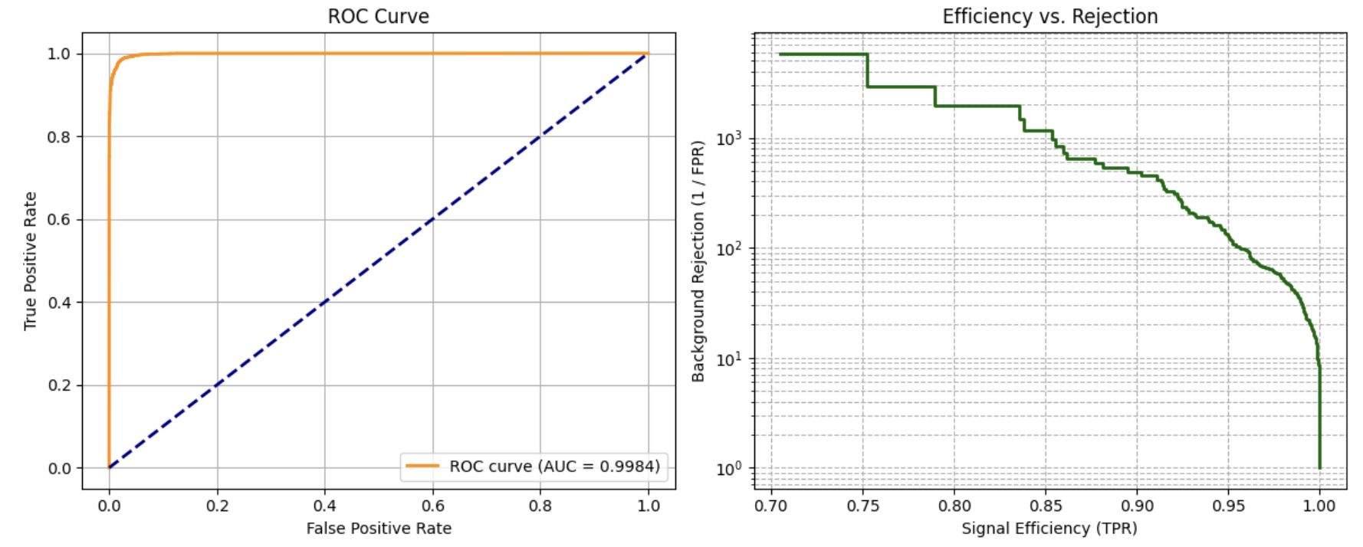
Outcome

